Slide 1
GIS Lesson 2
Projection and Coordinate System 投影法和座標系統
2020/5/6

Slide 2
Agenda
1. Introduction to Projection and Coordinate systems
A. Why do we need to have projection?
B. Types of Projection
Projection Methods
Properties
Aspect
Activity: Comparing different projections
Global vs. Local datums/projection
C. Geographic Coordinate systems vs. Projected Coordinate Systems
2. Interactive Activities
A. Scenarios – when to use which projection?
B. Changing Projection and Calculate Area using QGIS

Slide 3
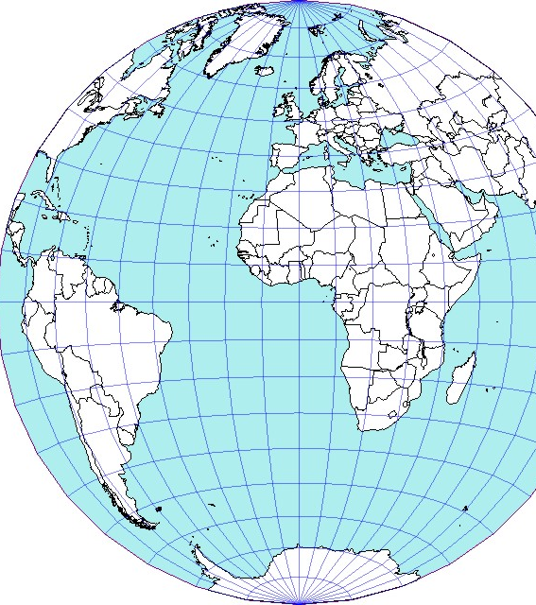
1. Introduction to Projection and Coordinate systems
投影法和座標系統的簡介
Notes:
Source: GEOG 187 Lecture 04 – Slide 47

Slide 4
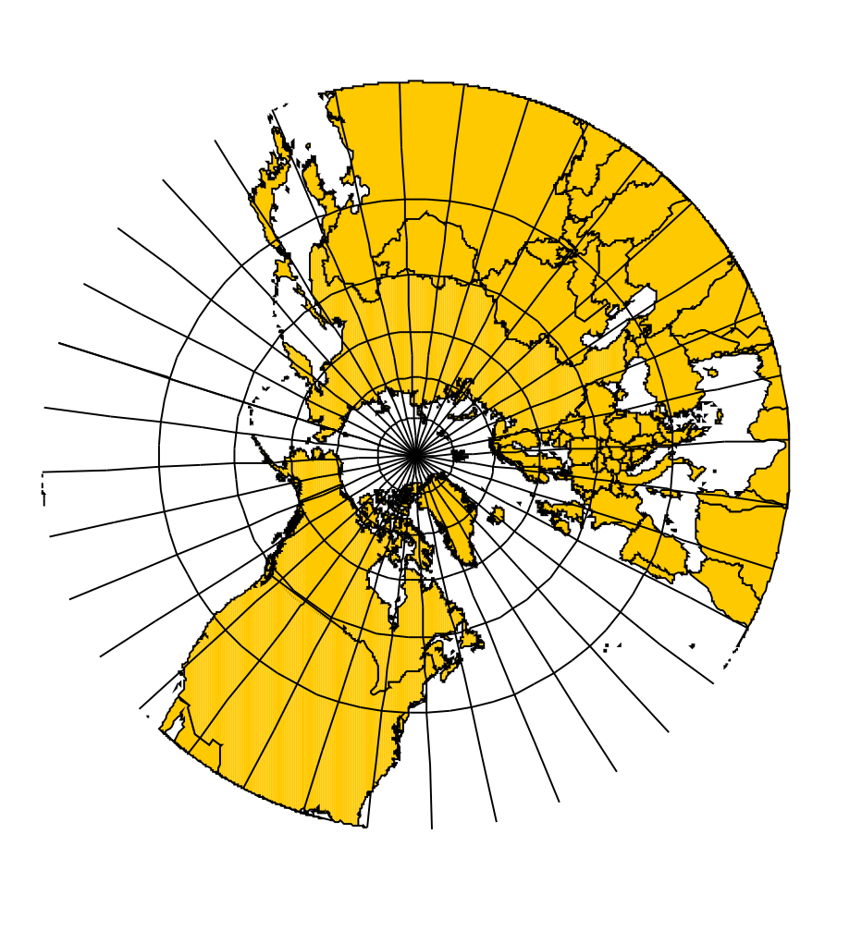
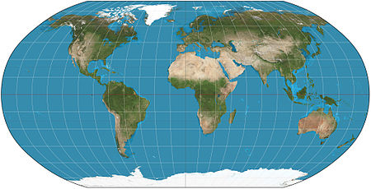
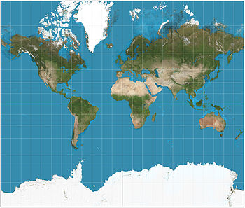
Which of the above is a correct representation of the Earth?
Robinson Projection
(羅賓森投影法)
Mercator Projection
(麥卡托投影法)
Gnomonic Projection
(球心切面投影法)
Source: GEOG 187 Fall 2015 – Lecture 04 Slide 19, 26, 40
Notes:
None of the above is an absolutely correct projection in representing the Earth, because information is lost when a 3D globe surface is converted into a 2D flat surface.
Robinson Projection: a compromise projection that minimizes the loss in area, shape, length etc.
Mercator Projection: most common projection used in world maps, good for navigation, north up, most accurate near the equator, but not preserving the area
Gnomonic Projection: Centered at the pole (north or south), good for navigation (shortest great circle routes as straight lines, but further from the pole are distorted

Slide 5
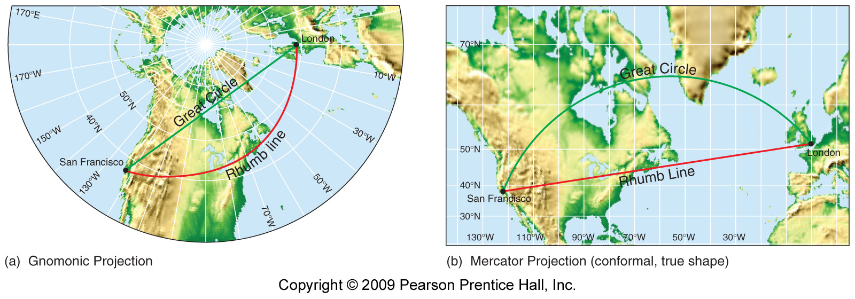
Which of the above projection is more suitable for finding the route with shortest distance?
Notes:
Gnomonic projection – representing great circle routes (shortest distance paths) as straight lines

Slide 6
A. Why do we need to have projection?
What problems can you think of during this process?
Transformation
(轉化)
Spherical surface
(3-D) （立體）
Flat surface
(2-D) （平面）
Purpose: To transform a curved 3D globe to a 2D flat surface.
目的：將立體和彎曲的地球轉換成平面表達出來。
Notes:
Source: GP 281 (Winter 2016) – Lecture 04 Slide 2
Major problem: Distortion – some information would be lost during the process.

Slide 7
B. Types of Projection
投影的種類

Slide 8
(i) Projection Methods (Physical Class) (投影方法、種類)
Cylindrical
(圓柱體)
Conic
(圓錐體)
Planar
(平面)
e.g. Mercator, Peters Projections
e.g. Lambert, Orthographic Projections
e.g. Gnomonic, Azimuthal Projections

Slide 9
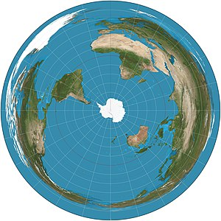
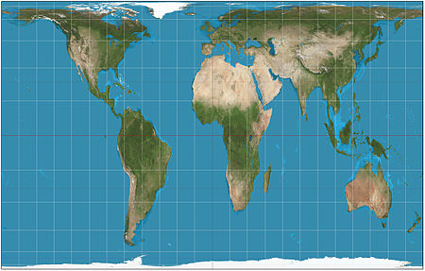
(ii) Projection Properties (投影屬性)
For the following three projections, what are their types?
Equivalence (等同面積): Preserving the area
Equidistant (等同距離): Preserving the scales and distance
Conformality (保形性): Preserving the shapes and angles
Conformal
(Mercator)
Equidistant
(Azimuthal)
Equivalence
(Gall-Peters)
Notes:
Source: GEOG 187 Lecture 4 – Slide 20, Wikipedia

Slide 10
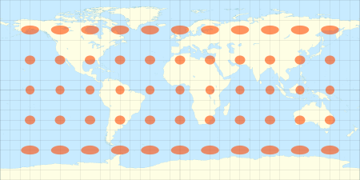
How to measure distortion? 如何量度扭曲之處?
Using Tissot Circles
Developed by Nicolas Auguste Tissot to measure the distortion of different projections
Analyzing the changes in shape, size and radius of the circles to determine what properties are preserved and what are lost
Source: GEOG 187 Lecture 04 – Slide 22
Comparing Projection Activity: https://map-projections.net/compare.php

Slide 11
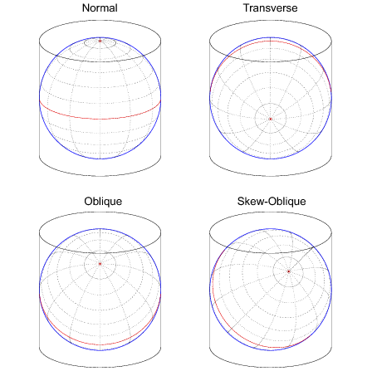
(iii) Projection Aspect (投影看點)
Normal: Main orientation of the projection surface is parallel to the Earth axis (主要方位平衡於地球的旋轉軸)
Transverse: Main orientation of the projection surface is perpendicular to the Earth axis (主要方位垂直於地球的旋轉軸)
Oblique (including Skew-oblique): Other non-parallel and non-perpendicular projections (所有非平衡和非垂直的投影法)
https://www.mathworks.com/help/map/projection-aspect.html
Notes:
Source: https://www.mathworks.com/help/map/projection-aspect.html

Slide 12
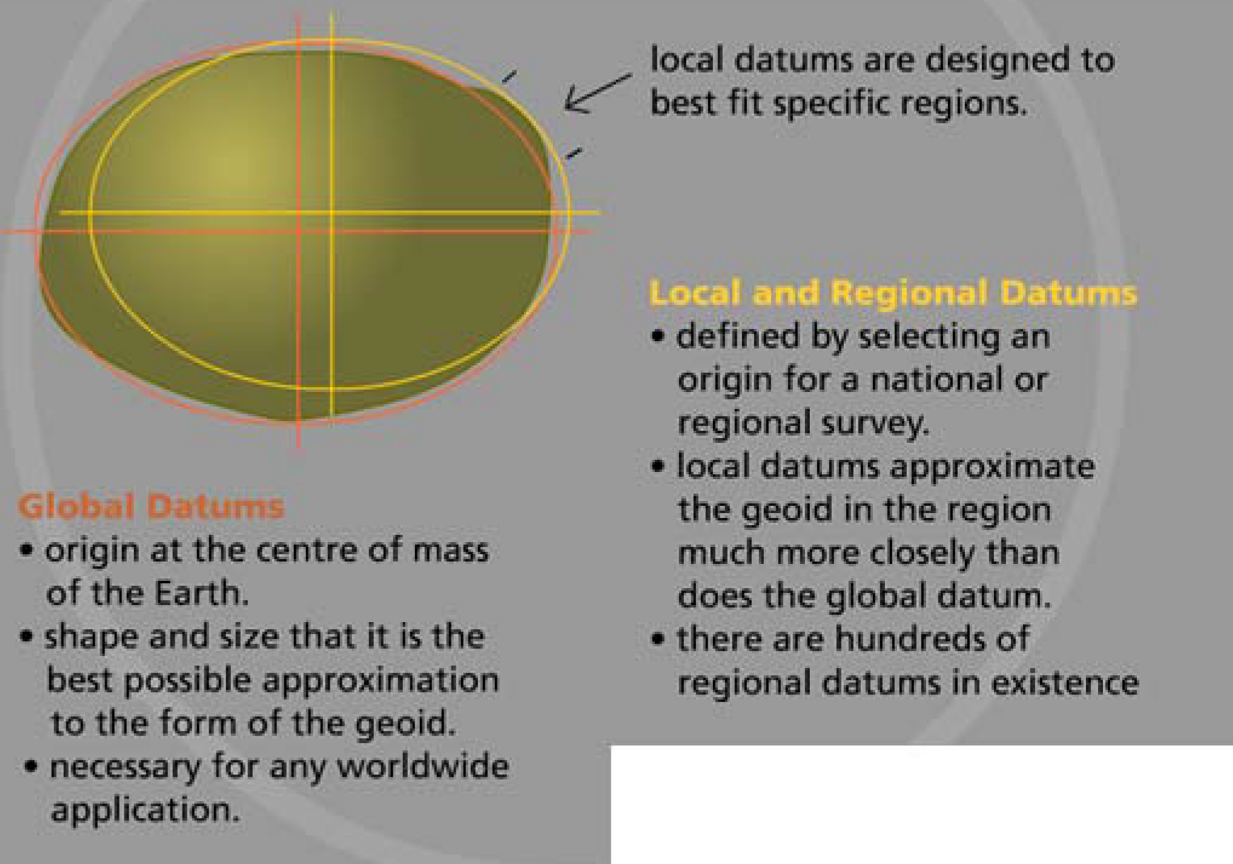
Global vs. Local datums/projections
Geoid (大地水准面): a theoretical surface of the Earth which is perpendicular to the direction of gravity at every point (每一點均垂直於重力的方向)
Datum (測量系統): a mathematical method to fit a projection to the Earth’s geoid
Global Datum (全球性測量系統): for worldwide use across continents (a base for global projections)
Local Datum (地區性測量系統): for local use in particular regions/areas
Source: GP281 (Winter 2016) – Slide 42

Slide 13
Global vs. Local coordinate systems examples
China Coordinate System: https://www.youtube.com/watch?v=L9Di-UVC-_4 (5:41)
Global Coordinate Systems
Local Coordinate Systems
WGS 1984 (commonly used across the world)
GCJ-02 (Used in China)
Lambert conformal conic (Used in aviation charts)
Winkel tripel
NAD 1983 UTM Zone 17N (Most commonly used in Ontario)
NAD 1983 State Plane New York Long Island FIPS 3104 Feet
Canada Lambert Conformal Conic
US National Atlas Equal Area

Slide 14
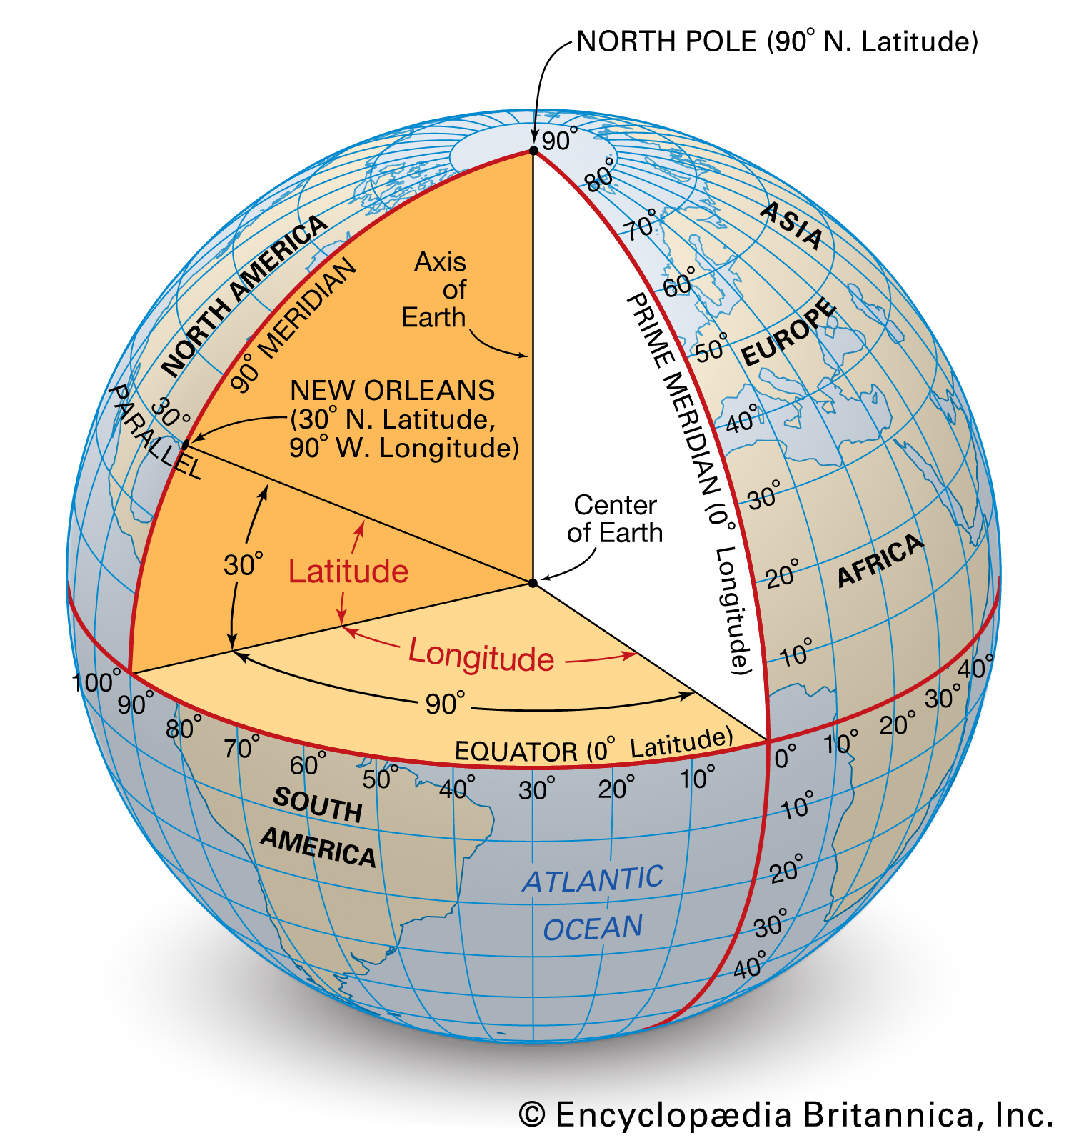
C. Geographic Coordinate Systems vs Projected Coordinate Systems (in GIS software)
Geographic Coordinate Systems (GCS)
E.g. WGS 1984
Based on a 3D representation of the Earth
Unit: Angular units (degrees)
Projected Coordinate Systems (PCS)
E.g. UTM
Based on a 2D plane representation of the Earth
Unit: Linear units (e.g. feet, meters)
Coordinate Systems
Geographic Coordinate Systems
Projected Coordinate Systems (Projections)
Based on 3D surface
Based on 2D projected surface
Source: https://gis.stackexchange.com/questions/182444/understanding-difference-between-coordinate-system-and-projection

Slide 15
2. Interactive Activities

Slide 16
Let’s have some scenarios!
1. Peter wants to compare the areas of Greenland and Africa visually. Which of the following projections is the best for him?
A. Mercator Projection
B. Azimuthal Equidistant Projection
C. Gall-Peters Projection
D. Robinson Projection
Notes:
C

Slide 17
Let’s have some scenarios!
2. Oscar wants to find the shortest route to fly from Sydney, Australia to Rio de Janeiro, Brazil . Which of the following projections is the best for him?
A. Mercator Projection
B. Azimuthal Equidistant Projection
C. Gall-Peters Projection
D. Robinson Projection
Notes:
B

Slide 18
Let’s have some scenarios!
3. Franky wants to know the relative direction of Beijing from Guangzhou. Which of the following projections is the best for him?
A. Mercator Projection
B. Azimuthal Equidistant Projection
C. Gall-Peters Projection
D. Robinson Projection
Notes:
B

Slide 19
Let’s have some scenarios!
4. Edgar wants to use a map projection that has the least distortion. Which of the following projections is the best for him?
A. Mercator Projection
B. Azimuthal Equidistant Projection
C. Gall-Peters Projection
D. Robinson Projection
Notes:
B

Slide 20
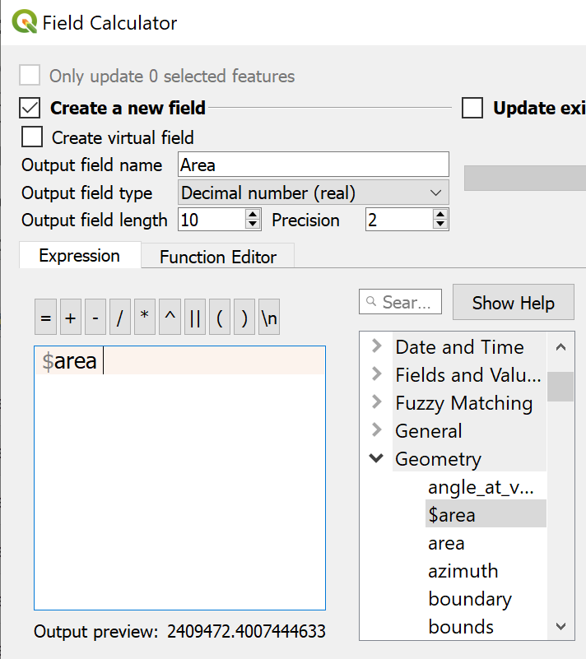
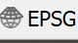

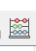
Changing Projection and Calculate Area Using QGIS
1. Open QGIS. Open a blank file.
2. Load the Kitchener-Waterloo Dissemination Area data layer.
3. Change the layer name to KW Dissemination Areas.
4. Check the coordinate system of the layer by clicking the icon . The icon could be found on the bottom right.
5. In the Filter box, type ‘26917’. Under Coordinate reference systems of the world, you should see NAD 83/ UTM zone 17N. Click the projection and click OK after you have selected.
6. You should now notice that the projection of the layer is now .
7. Then, one more extra thing is to calculate the area of each area polygon. To do this, first open the attribute table of the layer.
8. Open the Field Calculator by clicking .
9. In the field calculator, check Create a new field and type Area for field name with Decimal number (real) as the field type. Double-click to select $area under Geometry. Then, click OK after you have done.
10. Check Layer Properties > Information to confirm the measurement unit is meters for measuring distance. For area, the unit is then squared meters because area is a product of distances.

Slide 21
Questions?

